Slide 1
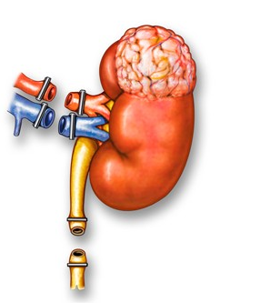
Nephroctomy
ا.م.د. رافد مجيد نعيم

Slide 2
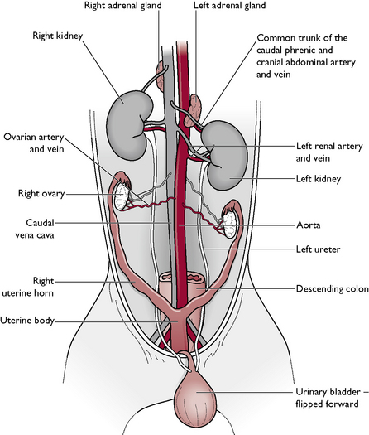
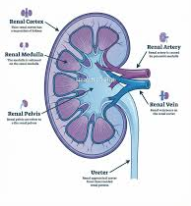
Anatomy
The kidneys lie in the retroperitoneal space lateral to the aorta and the caudal vena cava.
They have a fibrous capsule.
The cranial pole of the right kidney lies at approximately the level of the thirteenth rib, opposite the first three lumbar vertebrae.
The cranial pole of the left kidney lies opposite the second to fourth lumbar vertebrae, farther caudal than the right kidney by approximately half a kidney length
The renal pelvis is the funnelshaped structure that receives urine and directs it into the ureter

Slide 3
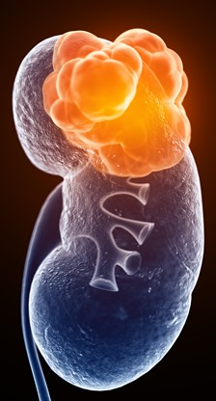
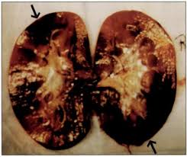
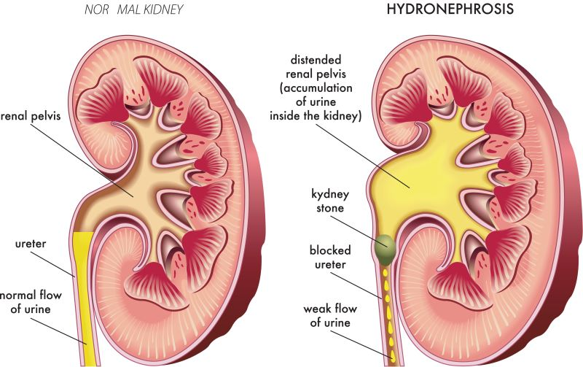
Nephrectomy
Nephrectomy is indicated for
1. renal neoplasia,
2. severe trauma resulting in uncontrollable hemorrhage or urine leakage,
3. hydronephrosis
Before nephrectomy, renal function in the opposite kidney should be assessed by determining its glomerular filtration rate (GFR) if possible. If excretory urograms are done, avoid large doses of contrast material and maintain good renal perfusion.

Slide 4
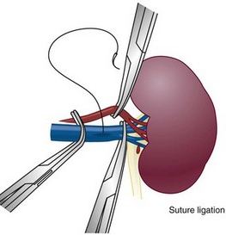
SUTURE MATERIALS AND SPECIAL INSTRUMENTS
Absorbable suture material such as
polyglactin 910 (Vicryl),
polyglycolic acid (Dexon),
polydioxanone (PDS),
polyglyconate (Maxon), or
poliglecaprone 25 (Monocryl)
should be used in the kidney, ureter, and bladder.
Nonabsorbable suture material may promote calculus formation and infection.
Although PDS and Maxon maintain tensile strength and are more slowly absorbed than is desirable for most urinary surgery, they have less tissue drag than Dexon or Vicryl.

Slide 5
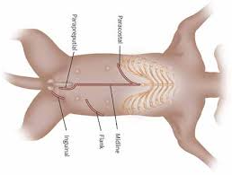
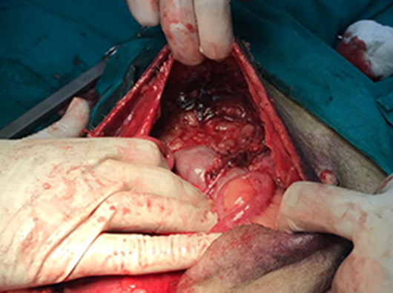
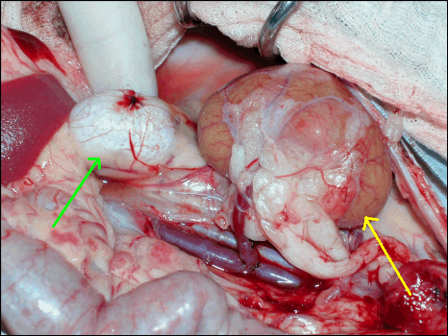
Surgical operation
For the kidney, a ventral midline abdominal incision is performed from the xiphoid to the pubis
Balfour retractors are used to retract the abdominal wall and expose the kidney
The entire abdominal contents should be inspected before exploring the urinary tract.
The kidney is exposed by deviating the vescera
The kidney can be isolated from the remaining abdominal contents with moistened laparotomy sponges.

Slide 6
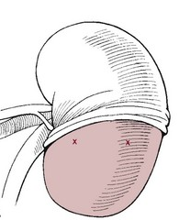
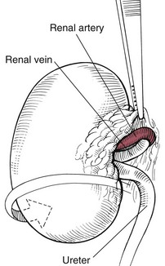
Grasp the peritoneum over the kidney and incise it.
Using a combination of blunt and sharp dissection, free the kidney from its sublumbar attachments.
Elevate the kidney and retract it medially to locate the renal artery and vein on the dorsal surface of the renal hilus

Slide 7
Double ligate the renal artery with absorbable suture (e.g., polydioxanone, polyglyconate, or pdiglecoprone 25) or nonabsorbable suture (e.g., cardiovascular silk) close to the abdominal aorta to ensure that all branches have been ligated.
the renal vein is ligated similarly.
Avoid ligating the renal artev and vein together to prevent the brmation of an arteriovenous fistula
Ligate the ureter near the bladder.
Remove the kidney and ureter and after procuring appropriate culture specimens, submit them for histologic examination

Slide 8

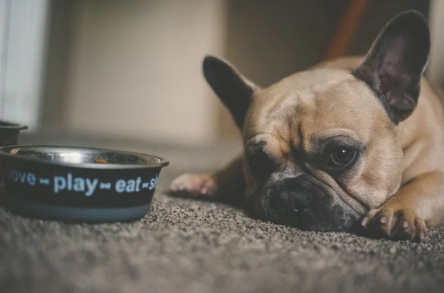
Post operative care
Systemic antibiotic for 3 days
Remove sutures after 7 days
Complications
Bleeding
Peritonitis
Abdominal dehiscence

Slide 9
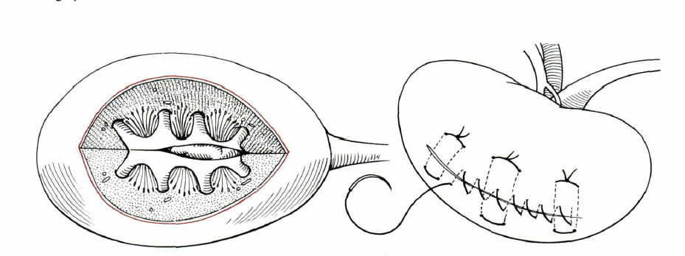
Nephrotomy
usually is performed to remove calculi
nephrotomy may temporarily diminish renal function by 25% to 50%.
Locate the renal vessels and,temporari/y occlude them with vascular forceps, a tourniquet, or an assistant's fingers
a sharp incision along the midline of the convex border of the kidney sufhcient to allow removal of the calculi and inspection of the entire renal pelvis
Culture the renal pelvis. Remove the calculi and flush the kidney with warm saline or lactated Ringer's solution fluids.
Nephrotomy incisions may be closed with transparenchymal horizontal mattress sutures

Slide 10
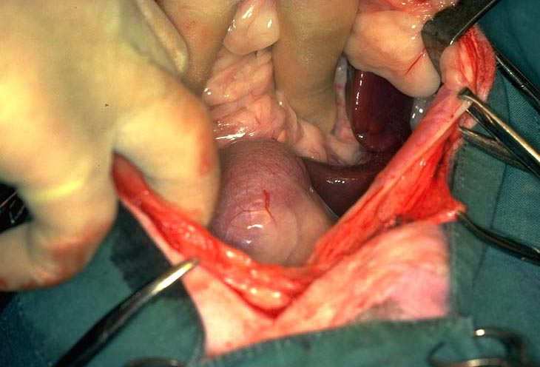
Close the nephrotomy by apposing the cut tissues and applying digital pressure for approximately 5 minutes while restoring blood flow through the renal vessels (sutureless technique).
As an alternative, appose the capsule with a continuous pattern of absorbable suture material.
If adequate hemostasis is not achieved or if urine leakage is a concern, place absorbable sutures through the cortex in a horizontal mattress. Then suture the capsule in a continuous pattern with absorbable suture. Replace the kidney in its original location.
Sutures may be placed in the peritoneum where the kidney was elevated to help stabilize it.

Slide 11


